Slide 1
Face Detection

Slide 2
Selective Search
1. Generate initial sub-segmentation, we generate many candidate regions
2. Use greedy algorithm to recursively combine similar regions into larger ones
3. Use the generated regions to produce the final candidate region proposals

Slide 3
R-CNN
To bypass the problem of selecting a huge number of regions, Ross Girshick et al. proposed a method where we use selective search to extract just 2000 regions from the image and he called them region proposals. Therefore, now, instead of trying to classify a huge number of regions, you can just work with 2000 regions. These 2000 region proposals are generated using the selective search algorithm.

Slide 4
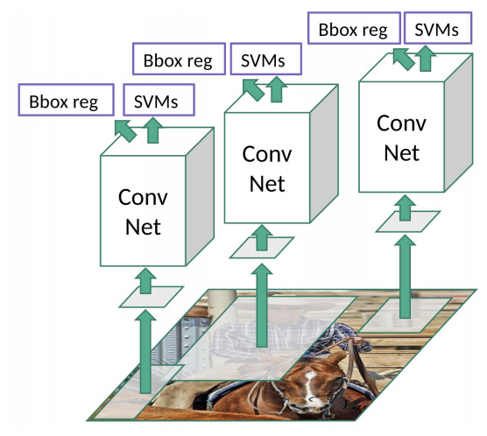
RCNN

Slide 5
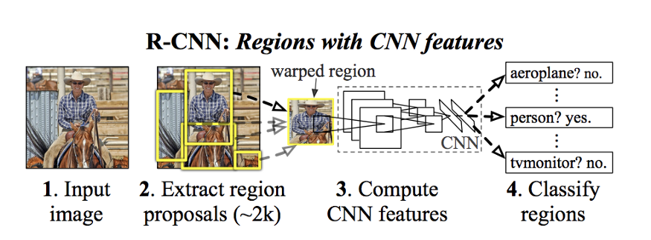

Slide 6
Fast R-CNN
The approach is similar to the R-CNN algorithm. But, instead of feeding the region proposals to the CNN, we feed the input image to the CNN to generate a convolutional feature map. From the convolutional feature map, we identify the region of proposals and warp them into squares and by using a RoI pooling layer we reshape them into a fixed size so that it can be fed into a fully connected layer. From the RoI feature vector, we use a softmax layer to predict the class of the proposed region and also the offset values for the bounding box.

Slide 7
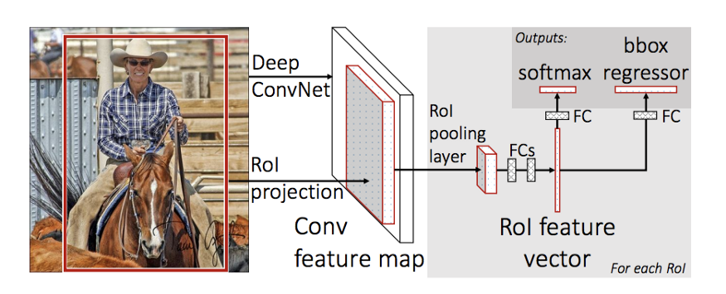
Fast R-CNN

Slide 8
Faster R-CNN
Similar to Fast R-CNN, the image is provided as an input to a convolutional network which provides a convolutional feature map. Instead of using selective search algorithm on the feature map to identify the region proposals, a separate network is used to predict the region proposals. The predicted region proposals are then reshaped using a RoI pooling layer which is then used to classify the image within the proposed region and predict the offset values for the bounding boxes.

Slide 9
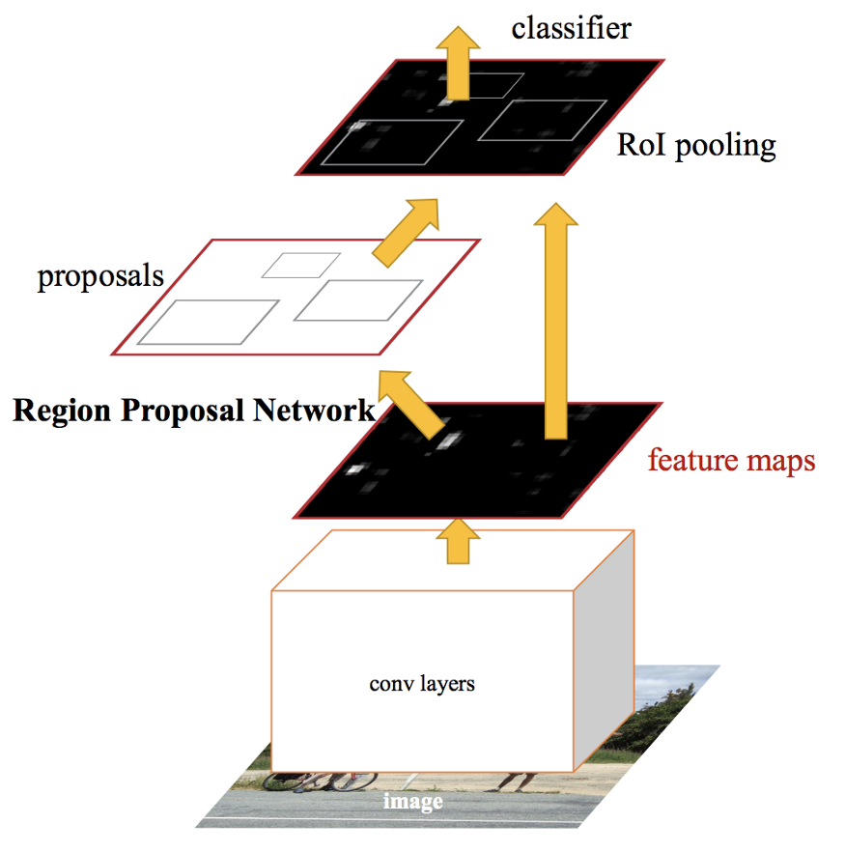
Faster R-CNN

Slide 10
YOLO - You Only Look Once
All of the previous object detection algorithms use regions to localize the object within the image. The network does not look at the complete image. Instead, parts of the image which have high probabilities of containing the object. YOLO or You Only Look Once is an object detection algorithm much different from the region based algorithms seen above. In YOLO a single convolutional network predicts the bounding boxes and the class probabilities for these boxes.
How YOLO works is that we take an image and split it into an SxS grid, within each of the grid we take m bounding boxes. For each of the bounding box, the network outputs a class probability and offset values for the bounding box. The bounding boxes having the class probability above a threshold value is selected and used to locate the object within the image.

Slide 11
